Slide 1



@HenleyPartners
Henley & Partners
/ HenleyPartners

Slide 2





Henley & Partners established industry leadership
Government advisory
Focus
Program design, implementation, and marketing
Ongoing support and strategic advice
Citizenship and residence planning
Program development for countries worldwide
Industry
Leadership
Track record
Clients
Industry pioneer
Over 25 years’ experience
Global citizens
Families and advisors
Governments
Reach
Global network of:
High-net-worth individuals
Governments, Agents and intermediaries
35+
Offices worldwide
25+
Years leading the industry
10 billion+
Foreign direct investments raised (USD)
30+
Investment migration options

Slide 3
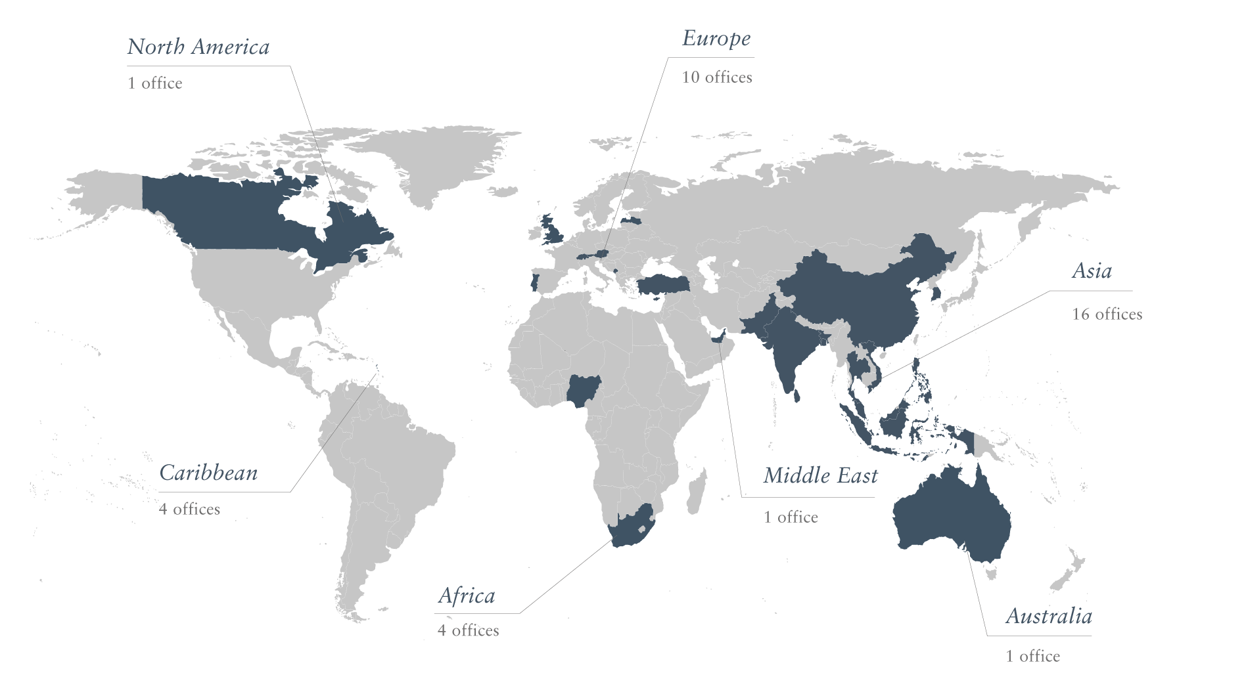
Global Presence — Over 35 Offices Worldwide

Slide 4

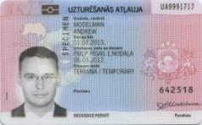
The Difference between Residence and Citizenship Programs
Citizenship
Grants the right to vote
Can be passed on to future generations
Allows international travel
Affords protection from the state
Residence
Grants the right to live, work, travel, and study in a country
Usually comes with conditions or requirements
May give some travel rights
Can be withdrawn
Is likely to affect tax status

Slide 5
Reasons for an Alternative Residence
Quality of Life
Security
Better quality of life, climate and personal security
Cleaner environment
Better healthcare and transport systems
Safe alternative in times of instability
More privacy in investment banking
A defined and stable legal environment
Education
Taxes
Graduation at high-ranking schools and language skills are becoming increasingly important as the basis for a successful career
Often the only way to reduce the tax burden and regulatory restrictions legally is to relocate

Slide 6
Reasons for a Second or Alternative Citizenship
Visa Waivers and Mobility
Independence and Retirement
Opens travel to countries previously restricted by time-consuming visa application processes
Freedom of movement when some nationals are overly exposed to physical or financial threats
Be able to travel or have the option to relocate at any time
Freedom to retire in a safe country without worrying about changing immigration laws
Privacy and Security
Tax Planning and Expatriation
Increased privacy in banking and improved physical security
Guarantees a secure a truly permanent alternative place to go; the permanent right to reside
Citizenship is one of the tie-breaker rules in most double tax treaties
To renounce citizenship another citizenship must be acquired first

Slide 7
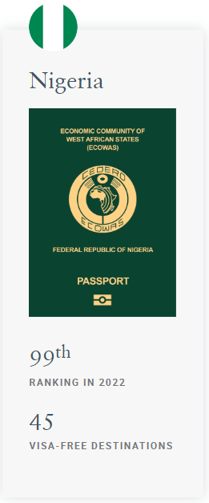







How does the Nigerian passport compare?
Countries offering Citizenship-by-Investment
Rank
Passport
Score
5
Austria
188
8
Malta
St. Kitts and Nevis
185
26
157
29
Antigua and Barbuda
150
33
St.Lucia
146
35
Grenada
144
38
Dominica
144
47
Montenegro
123
55
Turkey
110

Slide 8
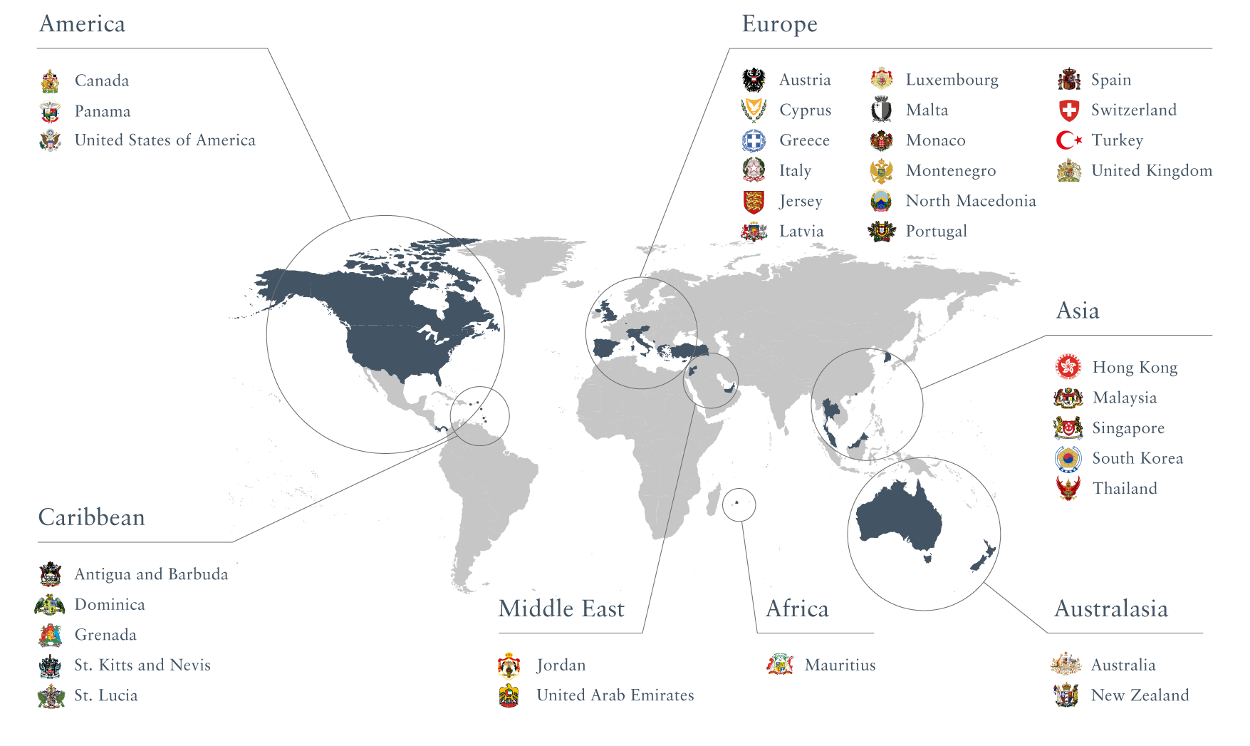
Leading Residence and Citizenship Programs
Notes:
Over 100 countries have some form of investment migration in place. There are over 60 active programs worldwide, with about 30 of those being relevant and successful.

Slide 9
Comparison of Caribbean CBI Programs
 | Antigua and Barbuda | Dominica | Grenada | St. Kitts and Nevis | St. Lucia
Government processing time: | 3 to 4 months | 3 to 4 months | 3 to 4 months | 2¹ to 4 months | 3 to 4 months
Visa-free access to | 150 countries | 144 countries | 144 countries | 157 countries | 146 countries
Important visa-free travel destinations | UK, Schengen, Singapore, Hong Kong | UK, Schengen, Singapore, Hong Kong | China, UK, Schengen, Singapore, Hong Kong | UK, Schengen, Singapore, Hong Kong | UK, Schengen, Singapore, Hong Kong
Minimum real estate purchase² | USD 200,000 | USD 200,000 | USD 220,000 | USD 200,000 / USD 400,000 | USD 300,000
Must hold period for real estate | Five years | Five years | Five years | Seven years / Five years | Five years
Minimum contribution² | USD 100,000 | USD 100,000 | USD 150,000 | USD 150,000 | USD 100,000
Physical presence required in the country | Five days within the first five years | None | None | None | None
¹ Accelerated Application Process is available for an additional due diligence fee payable to the government
² Cost represents the minimum contribution for a single applicant and would incur additional property transaction costs and/or misc. government fees, due diligence fees and
processing fees that differ per program

Slide 10
Comparison of European Citizenship Programs
 | Austria | Malta | Turkey
Government processing time: | ~ 24 months | ~ 18 months | ~ 6 months
Member of the EU: | Yes | Yes | No
Visa-free access to: | 188 countries | 185 countries | 110 countries
Important visa- free travel destinations: | Canada, Europe’s Schengen, UK, US, Singapore, Hong Kong | Canada, Europe’s Schengen, UK, US, Singapore, Hong Kong | Japan, Singapore, Hong Kong, Thailand
Minimum contribution¹: | EUR 3 million (donation) OR EUR 8 million (investment) | EUR 738,000 (at least EUR 600,000 donation) | USD 400,000 (real estate) OR USD 500,000 (fixed bank deposit)
Must hold period for assets: | N/A | Five years | Three years
Time required in the country: | Two mandatory visits and no physical presence requirement | Two mandatory visits and at least 14 days in 12 months from starting your application | One visit required and no physical presence requirement
¹ Costs represent the minimum contribution/investment for a single applicant and applicants would incur additional property transaction costs and/or misc. government fees, due diligence fees and processing fees

Slide 11
Comparison of European RBI Programs
 | Cyprus | Greece | Italy | Malta | Portugal
Government processing time: | 2 to 3 months | 2 to 3 months | 3 to 4 months | 4 to 6 months | 6 to 9 months
Member of the Schengen Area: | No | Yes | Yes | Yes | Yes
Minimum investment required: | EUR 300,000 | EUR 250,000 | EUR 250,000 to EUR 2 million | EUR 175,000 | EUR 280,000 to EUR 500,000
Nature of minimum investment: | Real Estate | Real Estate | Government Bond / Share Capital / Donation | Donation and Real Estate | Real Estate or other
Must hold period for investment | Permanent | Permanent | Two years | Five years | Five years
Visits required as part of application process: | One | Two | None | One | Two
Physical presence required in country | None | None | None | None | Effectively 7 days per year
Pathway to citizenship | Yes – after 5 years | Yes – after 7 years | Yes – after 10 years | N/A | Yes – after 5 years
¹

Slide 12
Comparison of Other RBI Programs
 | Canada | United States | United Kingdom
Government processing time: | 12 to 22 months | 16 to 18 months | 4 to 6 months
Minimum investment required: | USD 275,000 | USD 900,000 | GBP 50,000
Nature ofminimum investment: | Low Investment requirement - Innovative start-up business creation, approved by a designated organization | Regional Centre investment – creating 10 jobs | Capital investment
Must hold period for investment | N/A | Five years | Five years
Visits required as part of application process: | None prior to moving over | None | None
Physical presence required in country | Yes | Yes | Yes
Pathway to citizenship | Yes | Yes | Yes

Slide 13
Comprehensive Advisory Process
Focus:
Assign a personal advisor to the client.
Carefully analyze each client’s situation during the consultation process.
Develop a medium- to long-term residence and/or citizenship strategy.
Implement and manage all administrative tasks.
Procure the desired residence and/or citizenship option.
Provide ongoing support where necessary.
Introduction
of client
Ongoing strategy
optimization
Understand
client profile
Implement
strategy
Define
strategy

Slide 14


Cynthia Ekere
Client Advisor
Henley & Partners UK Ltd.
20 Grosvenor Place
Belgravia
London, SW1X 7HN
United Kingdom
T +44 207 052 4563
M +234 906 641 7312
E cynthia.ekere@henleyglobal.com
W henleyglobal.com

